Slide 1
Graphical Modeling
Dovan Rai, PHD
Dec 30, 2018

Slide 2
Outline
Graphical Models
Bayesian Networks
Causal Modeling
Graphical Modeling and Deep Learning (Discussion)

Slide 3
RECAP

Slide 4
Model

Slide 5
Model
Data

Slide 6
Model
Data
Parameters

Slide 7
Real World
Model
Data
Parameters

Slide 8
Uncertainty
Complexity
Likelihood
Modularity
Notes:
uncertainty: How much doubt do we have about a number coming from our model?
Ideally, this doubt can be quantitatively summarized.
complexity: How rough / smooth is the function that we end up fitting? More
complex functions have more roughness, on average.
likelihood: How plausible is the observed data under different configurations of
the model parameters?
modularity: How close is practical implementation to playing with lego blocks?
Ideally, can construct complex ML systems using simple, easi;y linkable building
blocks.

Slide 9
Inference
Prediction
Transformations
Minimization
Maximization
Optimization
Notes:
Transformations: Could be linear or nonlinear. Homogeneous coordinates as a trick to represent nonlinear transformations as a linear one. PCA projection is a linear transformation. Convolution is a linear transformation.
Optimization: We minimize a loss function or objective function. Can be a combination of minimization and maximization.

Slide 10
Probability
Statistics
Description
Prediction
Distribution
Association
Frequentist
Bayesian
Correlation
Regression

Slide 11

Real World
Uncertainty
Complexity
Model
Data
Likelihood
Modularity
Parameters
Probability
Statistics
Inference
Prediction
Description
Prediction
Distribution
Association
Transformations
Minimization
Frequentist
Bayesian
Maximization
Optimization
Correlation
Regression
Play with concepts and constructs you learn from books
on your own conceptual table.

Slide 12
Graphical Models

Slide 13
Graphical Models
Examples

Slide 14
(Probabilistic) Graphical Models
Smoking
Lung Cancer
Example 1

Slide 15
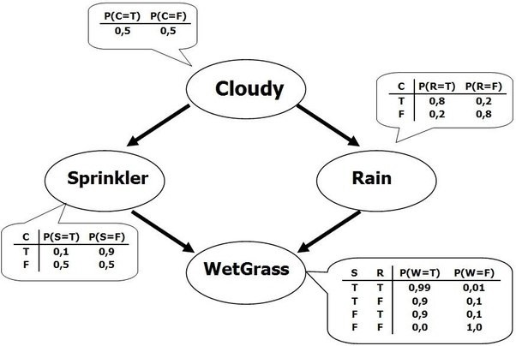
(Probabilistic) Graphical Models
Example 2

Slide 16
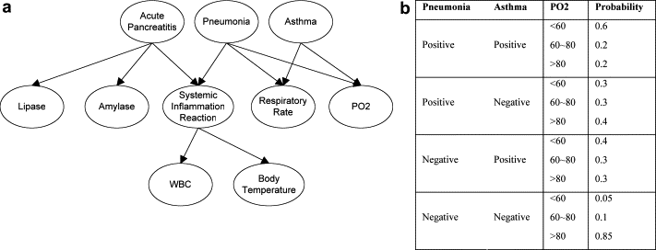
(Probabilistic) Graphical Models
Health Analytics

Slide 17
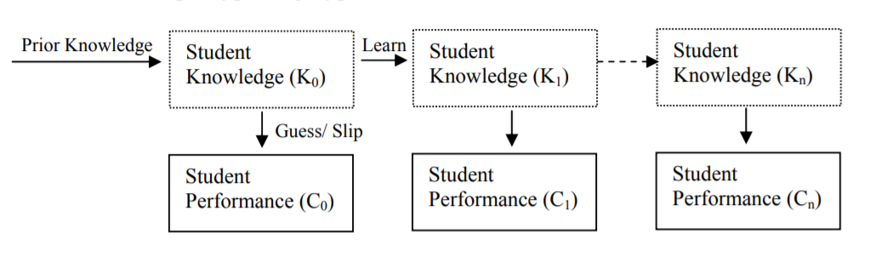
(Probabilistic) Graphical Models
Intelligent Tutoring Systems

Slide 18
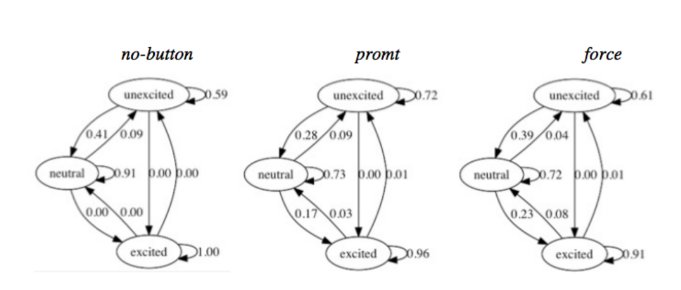
(Probabilistic) Graphical Models
Intelligent Tutoring Systems

Slide 19
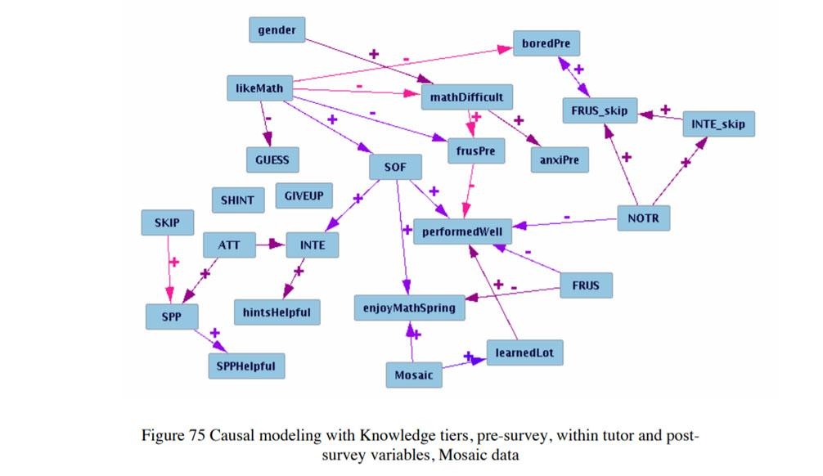
(Probabilistic) Graphical Models
Intelligent Tutoring Systems

Slide 20
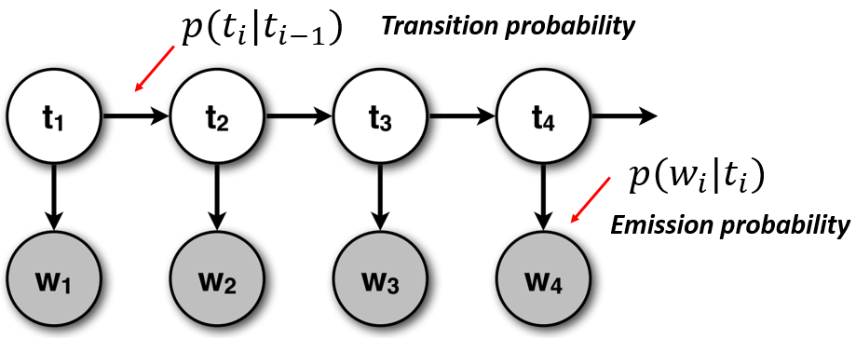
(Probabilistic) Graphical Models
Natural Language Processing

Slide 21
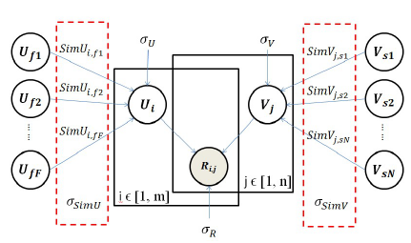
(Probabilistic) Graphical Models
Recommendation System

Slide 22
Graphical Models
Definitions

Slide 23
(Probabilistic) Graphical Models
Definition #1
Graphical Model consists of a graph structure.
Each node of the graph is associated with a random variable, and
the edges in the graph are used to encode relations between the random variables.

Slide 24
(Probabilistic) Graphical Models
Definition #1
Graphical Model consists of a graph structure.
Each node of the graph is associated with a random variable, and
the edges in the graph are used to encode relations between the random variables.
Definition #2
Graphical models are a marriage between probability theory and graph theory.

Slide 25
Definition #3
Graphical models comprise any model that uses the language of graphs to facilitate the representation and resolution of complex problems that use probability as representation of uncertainty.

Slide 26
Definition #3
Graphical models comprise any model that uses the language of graphs to facilitate the representation and resolution of complex problems that use probability as representation of uncertainty.
Definition #4
Graphical models are an elegant framework which combines uncertainty (probabilities) and logical structure (independence constraints) to compactly represent complex, real-world phenomena.

Slide 27
Graphical Models
What do they offer?

Slide 28
Graphical Models provide a natural tool for dealing with two problems that occur throughout applied mathematics and engineering - uncertainty and complexity. They provide a principled approach to dealing with uncertainty through the use of probability theory, and an effective approach to coping with complexity through the use of graph theory.

Slide 29
Graphical Models provide a natural tool for dealing with two problems that occur throughout applied mathematics and engineering - uncertainty and complexity. They provide a principled approach to dealing with uncertainty through the use of probability theory, and an effective approach to coping with complexity through the use of graph theory.
Fundamental to the idea of a graphical model is the notion of modularity -- a complex system is built by combining simpler parts.

Slide 30
Graphical Models provide a natural tool for dealing with two problems that occur throughout applied mathematics and engineering - uncertainty and complexity. They provide a principled approach to dealing with uncertainty through the use of probability theory, and an effective approach to coping with complexity through the use of graph theory.
Fundamental to the idea of a graphical model is the notion of modularity -- a complex system is built by combining simpler parts.
The graphical model framework provides a way to view systems as instances of a common underlying formalism. Specialized techniques that have been developed in one field can be transferred between research communities and exploited more widely. Moreover, the graphical model formalism provides a natural framework for the design of new systems.

Slide 31
Graphical Models provide a natural tool for dealing with two problems that occur throughout applied mathematics and engineering - uncertainty and complexity. They provide a principled approach to dealing with uncertainty through the use of probability theory, and an effective approach to coping with complexity through the use of graph theory.
Fundamental to the idea of a graphical model is the notion of modularity -- a complex system is built by combining simpler parts.
The graphical model framework provides a way to view systems as instances of a common underlying formalism. Specialized techniques that have been developed in one field can be transferred between research communities and exploited more widely. Moreover, the graphical model formalism provides a natural framework for the design of new systems.
Three components — representation, inference, and learning — are critical components in constructing an intelligent system. Probabilistic graphical models are one of a small handful of frameworks that support all three capabilities for a broad range of problems.

Slide 32
Graphical Models are all-encompassing !
Graphical Models are
intuitive and rigorous.

Slide 33
Graphical Models are awesome !!
❤

Slide 34
Definition #2
Graphical models are a marriage between probability theory and graph theory.
GT
PT
GM

Slide 35
Definition #2
Graphical models are a marriage between probability theory and graph theory.
GT
PT
GM
Graph Theory
provides both an intuitively appealing interface by which humans can model highly-interacting sets of variables as well as a data structure.
Probability Theory
provides the glue whereby the parts are combined, ensuring that the system as a whole is consistent, and providing ways to interface models to data.

Slide 36
But how much graph theory is there in Graphical Modeling?
Max-flow Min-cut theorems
Euler's Theorem
Handshaking Lemma
Vertex and Edge
Not much actually !
“If student A were an expert in probability but knew nothing about graph theory, and student B were an expert in graph theory but knew nothing about probability, then A would certainly learn and understand probabilistic graphical models faster than would B.”

Slide 37
But how much graph theory is there in Graphical Modeling?
Max-flow Min-cut theorems
Euler's Theorem
Handshaking Lemma
Vertex and Edge
Not much actually !
“If student A were an expert in probability but knew nothing about graph theory, and student B were an expert in graph theory but knew nothing about probability, then A would certainly learn and understand probabilistic graphical models faster than would B.”
Let’s go to Probability !!

Slide 38
Joint Probability and Conditional Probability
Joint probability is a measure that calculates the likelihood of two events occurring together and at the same point in time.
Example: probability of picking up a card that is both red and 6
P(6 ∩ red) = 2/52 = 1/26
Conditional probability is the measure that one event will happen given that another action or event happens.
Example: probability that you get a six, given that you drew a red card
P(6│red) = 2/26 = 1/13

Slide 39
Dependence and Independence
When two events are dependent events, one event influences the probability of another event.
Example: Travelling to Kathmandu and suffering from allergy.
When two events are independent events, one event has no connection to another event’s chances of happening (or not happening).
Example: Travelling to Kathmandu and meteor falling on Jupiter .

Slide 40
Independence and Conditional Independence
Independence: Events A,B are independent if knowing that A happened would not tell you anything about whether B happened (or vice versa).
Example: P(A∩B)=P(A).P(B)
P(A|B)=P(A)
Conditional Independence: Events A,B are conditionally independent given a third event C means the following: Suppose you already know that C has happened, then knowing whether A happened would not convey any further information about whether B happened.
A is conditionally independent of B given C means
P(A|B,C) = P(A|C)

Slide 41
Back to Graphical Models

Slide 42
Types of Graphical Models
Undirected Graphical Models
Directed Graphical Models
Undirected graphical models are called Markov Models/ Markov Networks.
They have a simple definition of independence.
More popular with the physics and vision communities
Directed Graphical Models are called Bayesian Networks/ Bayes Nets/ Belief Networks.
They have a more complex definition of independence.
More popular with the AI and statistics communities.

Slide 43
Bayesian Network
A Bayesian network is a directed acyclic graph in which each edge corresponds to a conditional dependency, and each node corresponds to a unique random variable.
Bayesian networks uses Bayesian inference for probability computations.

Slide 44
Bayesian Network
Representation
Inference
Learning

Slide 45
Representation in Bayesian Network
A Bayesian network consists of two parts:
a qualitative part (expressing the relationships between the variables with semantics based on the concept of conditional independence) and
a quantitative part (the numerical values of a set of conditional probability distributions).

Slide 46
Knowledge
Knowledge
True | False
a | b
Perform Correct
Perform
Correct
Knowledge | True | False
Knowledge =True | c | d
Knowledge =False | e | f

Slide 47
Qualitative Part:
Graph
Quantitative Part:
Conditional Probability Tables (CPT)
Knowledge
Knowledge
True | False
a | b
Perform Correct
Perform
Correct
Knowledge | True | False
Knowledge =True | c | d
Knowledge =False | e | f

Slide 48
Quantitative Part:
??
Knowledge
Knowledge
True | False
a | b
Perform Correct
Perform
Correct
Knowledge | True | False
Knowledge =True | c | d
Knowledge =False | e | f

Slide 49
Knowledge
Knowledge
True | False
0.5 | 0.5
Perform Correct
Perform
Correct
Knowledge | True | False
Knowledge =True | c | d
Knowledge =False | e | f

Slide 50
Ideal Condition
Knowledge
Knowledge
True | False
0.5 | 0.5
Perform Correct
Perform
Correct
Knowledge | True | False
Knowledge =True | 1 | 0
Knowledge =False | 0 | 1

Slide 51
Guessing and Slipping
Knowledge
Knowledge
True | False
0.5 | 0.5
Perform Correct
Perform
Correct
Knowledge | True | False
Knowledge =True | 0.8 | 0.2
Knowledge =False | 0.3 | 0.7

Slide 52

Model Student A:
High knowledge
Careless
Knowledge
Knowledge
True | False
0.9 | 0.1
Perform Correct
Perform
Correct
Knowledge | True | False
Knowledge =True | 0.6 | 0.4
Knowledge =False | 0.3 | 0.7

Slide 53

Model Student B:
Low knowledge;
Clever at guessing
Knowledge
Knowledge
True | False
0.3 | 0.7
Perform Correct
Perform
Correct
Knowledge | True | False
Knowledge =True | 0.8 | 0.2
Knowledge =False | 0.6 | 0.3

Slide 54

Model Tutor A:
Only two options as multiple choice
Knowledge
Knowledge
True | False
0.5 | 0.5
Perform Correct
Perform
Correct
Knowledge | True | False
Knowledge =True | 0.8 | 0.2
Knowledge =False | 0.5 | 0.5
4 | 3

Slide 55

Model Tutor B:
Confusing Interface
Knowledge
Knowledge
True | False
0.5 | 0.5
Perform Correct
Perform
Correct
Knowledge | True | False
Knowledge =True | 0.4 | 0.6
Knowledge =False | 0.3 | 0.7

Slide 56

Model Classroom A:
High Knowledge
Students
Knowledge
Knowledge
True | False
0.9 | 0.1
Perform Correct
Perform
Correct
Knowledge | True | False
Knowledge =True | 0.8 | 0.2
Knowledge =False | 0.3 | 0.7

Slide 57

Model Classroom B:
Cheaters
Knowledge
Knowledge
True | False
0.5 | 0.5
Perform Correct
Perform
Correct
Knowledge | True | False
Knowledge =True | 0.8 | 0.2
Knowledge =False | 0.7 | 0.3

Slide 58
Knowledge
Cheating
Perform
Correct

Slide 59
Knowledge
Cheating
Cheating
Knowledge
True | False
c | d
True | False
a | b
Perform Correct
Knowledge | Cheating | True | False
True | True | e | f
True | False | g | h
False | True | i | j
False | False | k | l
Perform
Correct

Slide 60
Discipline
Knowledge
Cheating
Perform
Correct

Slide 61
Where do these Conditional Probability Tables (CPT) come from? How do you acquire CPTs ?
How do you process CPTs ?

Slide 62
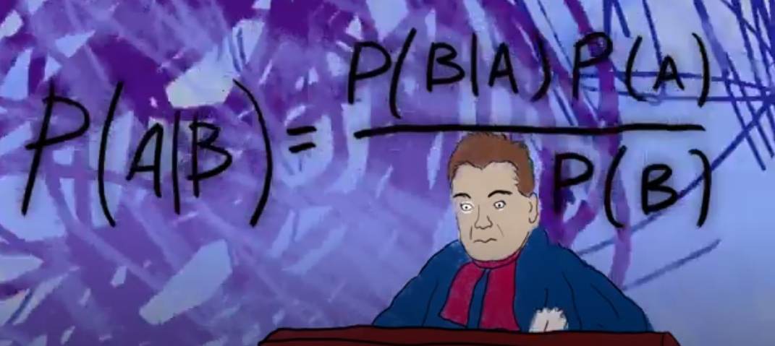
Inference in Bayesian Network
Bayesian Inference: Bayes comes into Bayesian Network.

Slide 63
Knowledge
Knowledge
Perform Correct
True | False
0.5 | 0.5
Knowledge | True | False
True | 0.8 | 0.2
False | 0.3 | 0.7
Perform
Correct
This is a probabilistic graphical representation of knowledge-performance model.

Slide 64
Knowledge
Knowledge
Perform Correct
True | False
0.5 | 0.5
Knowledge | True | False
True | 0.8 | 0.2
False | 0.3 | 0.7
Perform
Correct
This is a probabilistic graphical representation of knowledge-performance model.
It tells us how the performance would be like given knowledge.

Slide 65
Knowledge
Knowledge
Perform Correct
True | False
0.5 | 0.5
Knowledge | True | False
True | 0.8 | 0.2
False | 0.3 | 0.7
Perform
Correct
This is a probabilistic graphical representation of knowledge-performance model.
It tells us how the performance would be like given knowledge.
But in real-world, we can see performance but cannot see knowledge.

Slide 66
Knowledge
Knowledge
Perform Correct
True | False
0.5 | 0.5
Knowledge | True | False
True | 0.8 | 0.2
False | 0.3 | 0.7
Perform
Correct
This is a probabilistic graphical representation of knowledge-performance model.
It tells us how the performance would be like given knowledge.
But in real-world, we can see performance but cannot see knowledge.
Knowledge is hidden (latent)

Slide 67
Knowledge
Knowledge
Perform Correct
True | False
0.5 | 0.5
Knowledge | True | False
True | 0.8 | 0.2
False | 0.3 | 0.7
Perform
Correct
This is where Bayesian Inference comes.
Using the Bayes Theorem, we can deduce ‘knowledge’ from ‘performance’.

Slide 68
Knowledge
Knowledge
Perform Correct
True | False
0.5 | 0.5
Knowledge | True | False
True | 0.8 | 0.2
False | 0.3 | 0.7
Perform
Correct
P(Know) : CPT
P(Correct) : Observable
P(Correct | Know) : CPT
P(Know | Correct) = ?
P(Know | Correct)=P(Correct| Know)*P(Know)
P(Correct)

Slide 69
Knowledge
Knowledge
In Dynamic Bayesian Networks,
Bayesian Inference is used to predict future unobserved variables.
Perform
Correct
Perform
Correct
P(Know) : CPT
P(Correct) : Observable
P(Know | Correct) : Inferred and updated
P(Correct | Know) =?
P(Correct | Know )=P(Know | Correct)*P(Correct)
P(Know)
P(Know) : CPT
P(Correct) : Observable
P(Correct | Know) : CPT
P(Know | Correct) = ?
P(Know | Correct)=P(Correct| Know)*P(Know)
P(Correct)

Slide 70
Learning in Bayesian Networks
Maximum Likelihood Estimation (ML)
Expectation-Maximization (EM)
Gradient Descent
Markov Chain Monte Carlo (MCMC)

Slide 71
Learning in Bayesian Networks
Knowledge Tracing Model: Dynamic Bayesian Network

Slide 72
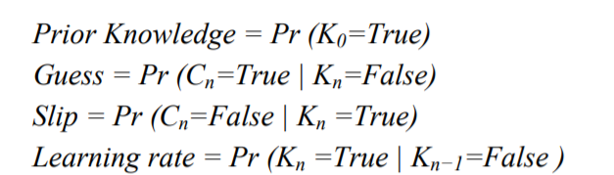
Learning in Bayesian Networks
Knowledge Tracing Model: Dynamic Bayesian Network

Slide 73
Learning in Bayesian Networks
Knowledge Tracing Model: Dynamic Bayesian Network
Input :
Performance Data
(Observed)
Knowledge Tracing Model
Expectation-
Maximization (EM)
Algorithm
Output :
Model Parameters
(hidden)
Predicted Performance
(unobserved)

Slide 74
Learning in Bayesian Networks
Knowledge Tracing Model: Dynamic Bayesian Network
Input :
Performance Data
(Observed)
Output :
Model Parameters
(Unobserved)
Knowledge Tracing Model
Expectation-
Maximization (EM)
Algorithm
Student | Time | Performance
A | a | 0
A | b | 1
B | a | 1
B | b | 1
C | a | 0
Parameters | Value
Prior Knowledge | 0.52
Learning | 0.09
Guess | 0.39
Slip | 0.16

Slide 75
What do we do with these parameters?
Helps to predict next performance.
How is the student going to perform in next question?
Shall we give more difficult problem?
Shall we offer help?

Slide 76
What do we do with these parameters?
Helps to predict next performance.
How is the student going to perform in next question?
Shall we give more difficult problem?
Shall we offer help?
Do they help us understand student learning behavior?
This is where it gets tricky !

Slide 77
Limitations of Learning in Bayesian Networks
Multiple global maxima.
In EM, we need to start from some priors.
Final parameter estimations are sensitive to those initial values.

Slide 78
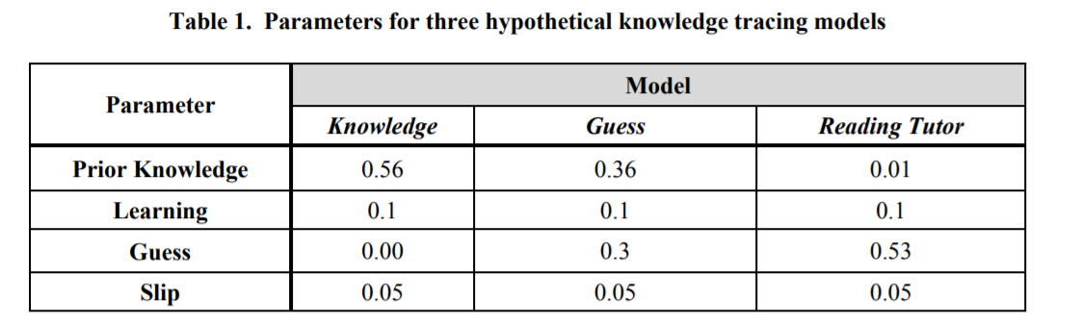
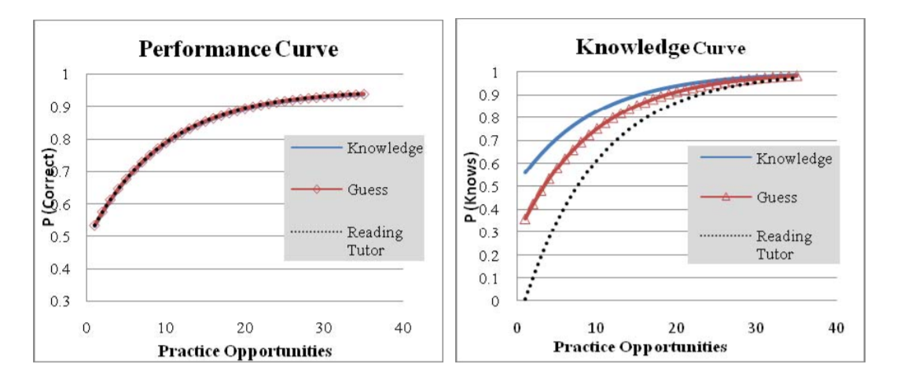

Slide 79
Bayesian Networks are good at prediction.
But still compromised at understanding.
That leads us to Causality !!

